Slide 1
Machine Learning Clustering Algorithms

Slide 2
Affinity Propagation Clustering
Affinity Propagation is a clustering algorithm that automatically finds the number of clusters based on message passing between data points.
Every data point considers all other points as potential exemplars (cluster centers).
Through an iterative process, points send messages to each other to decide which are best exemplars.

Slide 3
How it Works?
Input: Similarity matrix (e.g., negative distances between points).
Each point considers all others as potential exemplars.
Two message types are passed:
Responsibility (r): How well a point fits as a cluster center.
Availability (a): How appropriate it is to choose a point as center.
Messages update until clusters form

Slide 4
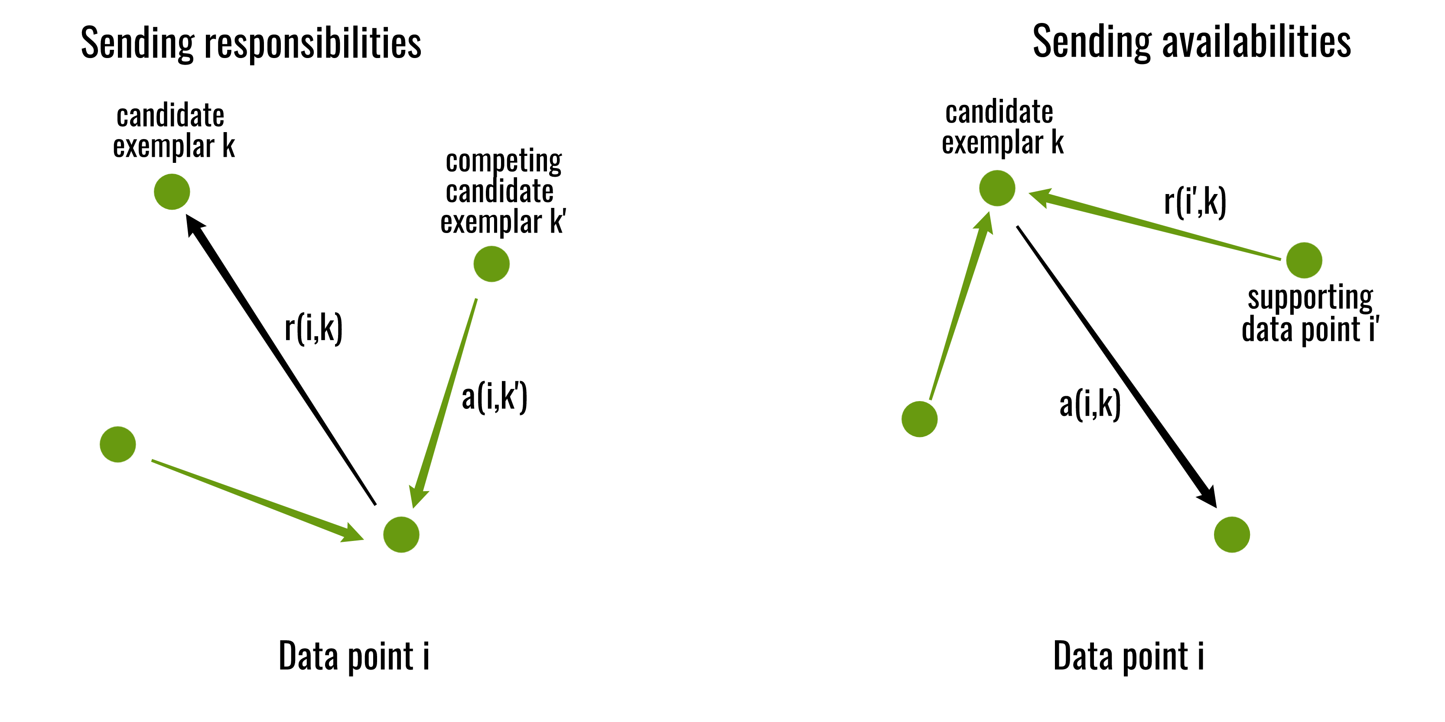
Steps
Compute similarities between all pairs of points.
Initialize responsibility and availability messages.
Iterate:
Update r(i, k) and a(i, k) based on current values.
Identify exemplars.
Assign each point to an exemplar → clusters!

Slide 5
Advantages
No need to specify the number of clusters
Can find non-convex clusters
All points are considered as potential exemplars
Works well with pairwise similarity input
Disadvantages
Computationally expensive → Time and memory complexity is O(N²) — not ideal for large datasets.
Sensitive to preference parameter
Slower convergence
Not suitable for very large datasets

Slide 6
Mean Shift Clustering
A centroid-based, density-driven clustering algorithm
It doesn't require the number of clusters to be set in advance.
Works by shifting data points toward the densest region in their neighborhood (the “mean”).
Each data point shifts like it's “climbing a hill” to reach a density peak — those peaks become cluster centers.

Slide 7
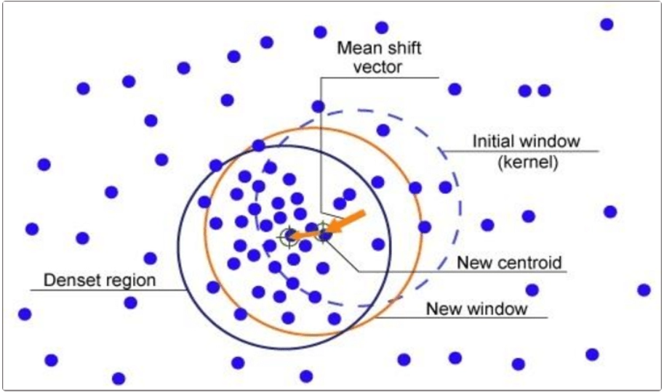
How it Works?
Choose a bandwidth(window size)
For each point:
Find neighboring points within the window.
Compute the mean of neighbors.
Shift the point to this mean.
Repeat until points converge (no more movement).
Points that converge to the same location → form a cluster.
Bandwidth is a key parameter:
Small = more clusters
Large = fewer clusters

Slide 8
Advantages
No need to choose number of clusters.
Detects arbitrarily shaped clusters.
Handles noise and outliers better than K-Means.
Disadvantages
Computationally slow on large datasets.
Very sensitive to bandwidth.
May merge nearby clusters or over-split.

Slide 9
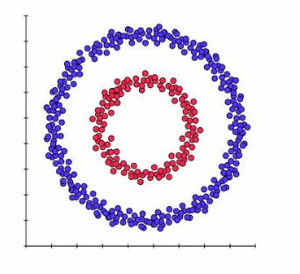
Spectral Clustering
Spectral Clustering is a smart way to group data using graphs instead of just distances.
It turns your data into a graph, where each point is a node.
Points that are similar are connected
Then, it looks at how strongly points are connected — not just how close they are.
To find the groups:
It uses math (eigenvalues) to simplify the data.
After that, it groups the simplified data using a basic method like K-Means.

Slide 10
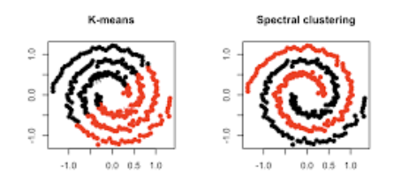
How it Works?
Build a similarity graph from data (e.g., using nearest neighbors).
Construct a Laplacian matrix from the graph.
Compute the eigenvectors of the Laplacian.
Use the top eigenvectors to reduce dimensionality.
Apply a standard clustering method (like K-Means) on the reduced space.
📌 Often used when data is not linearly separable.

Slide 11
Advantages
Can find complex, non-convex clusters.
Based on graph theory, so works well with structured data.
Effective in image segmentation and social network analysis.
Disadvantages
Needs to specify number of clusters.
Computationally expensive (eigen decomposition).
Sensitive to the choice of similarity measure.

Slide 12
DBSCAN Clustering
DBSCAN = Density-Based Spatial Clustering of Applications with Noise
It Groups points that are close together (dense regions) and Marks isolated points as noise or outliers
It can find clusters of any shape and detect outliers.
It looks for areas where many points are close together and marks anything too far away as noise (outliers).

Slide 13
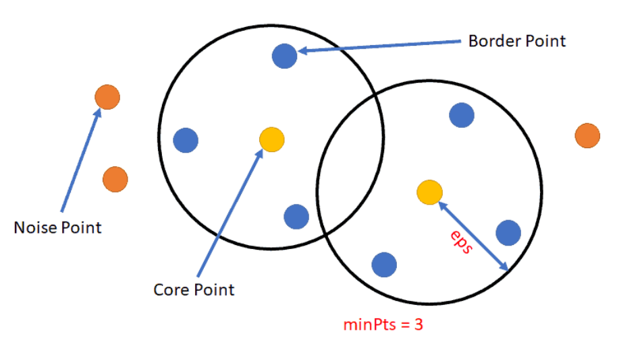
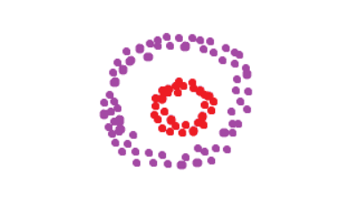
How it Works?
Pick two parameters:
ε (epsilon): distance to look for neighbors.
MinPts: minimum number of neighbors to form a dense region.
Classify each point as:
Core Point: enough neighbors inside ε.
Border Point: near a core, but not dense enough on its own.
Noise Point: not near any core.
Form clusters by connecting core points and their neighbors.
Result: Clusters + Outliers (noise)

Slide 14
Advantages
No need to specify number of clusters.
Finds arbitrary shaped clusters.
Can detect noise/outliers.
Good for spatial and geodata.
Disadvantages
Struggles with varying densities.
Choosing the right ε and MinPts can be tricky.
Not ideal for high-dimensional data.

Slide 15
OPTICS Clustering
OPTICS = Ordering Points To Identify the Clustering Structure
It is a density-based clustering algorithm, like DBSCAN.
Unlike DBSCAN, it does not require a fixed distance (ε) to find clusters.
It produces an ordering of points that shows how clusters are structured.
OPTICS builds a reachability plot to reveal clusters of different densities.

Slide 16
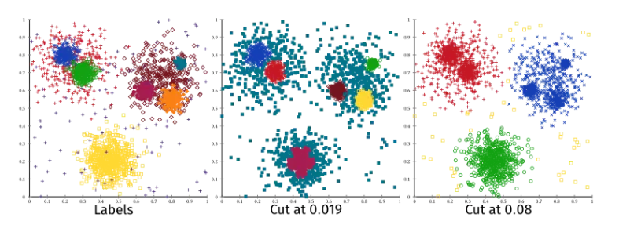
How it Works?
Set a MinPts value (minimum points to form a cluster).
For each point:
Compute core distance and reachability distance.
Points are ordered based on how they can be reached from each other.
Use the reachability plot to visualize and extract clusters.

Slide 17
Advantages
Can detect clusters with different densities.
No need to choose a strict ε value
Detects arbitrary-shaped clusters.
Can be visualized using a reachability plot.
Disadvantages
Slower than DBSCAN.
Output is not direct clusters, but an ordering — needs interpretation.
More complex to understand and implement.

Slide 18
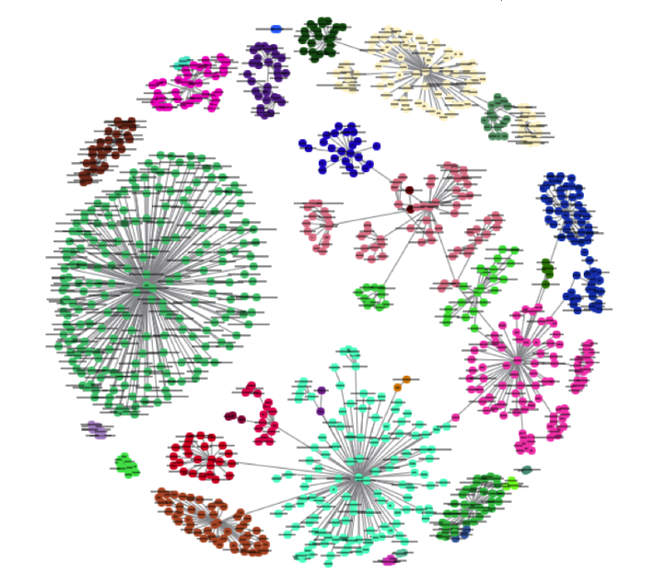
BIRCH Clustering
BIRCH = Balanced Iterative Reducing and Clustering using Hierarchies
It is a clustering method designed for large datasets.
Builds a tree structure to summarize data (called a CF tree).
Very fast and memory-efficient.
Instead of clustering all points directly, it builds a compact summary of the data and clusters that.

Slide 19
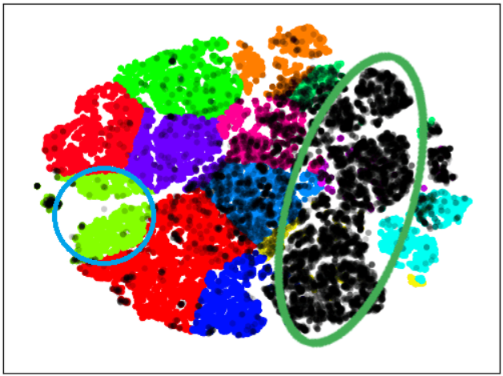
How it Works?
Input data is scanned to build a CF (Clustering Feature) tree:
Nodes summarize clusters with basic statistics.
New data points are incrementally added.
Once the CF tree is built:
Apply a standard clustering algorithm (like K-Means) to the leaf nodes.
Works in multiple passes over the data (if needed).
Best for large-scale data clustering

Slide 20
Advantages
Very efficient and scalable.
Works well with large and streaming data.
Can handle noise and outliers.
Supports incremental clustering.
Disadvantages
Best for spherical-shaped clusters.
Results depend on tree structure parameters (like branching factor, threshold).
Not ideal for high-dimensional or sparse data.

